Slide 1
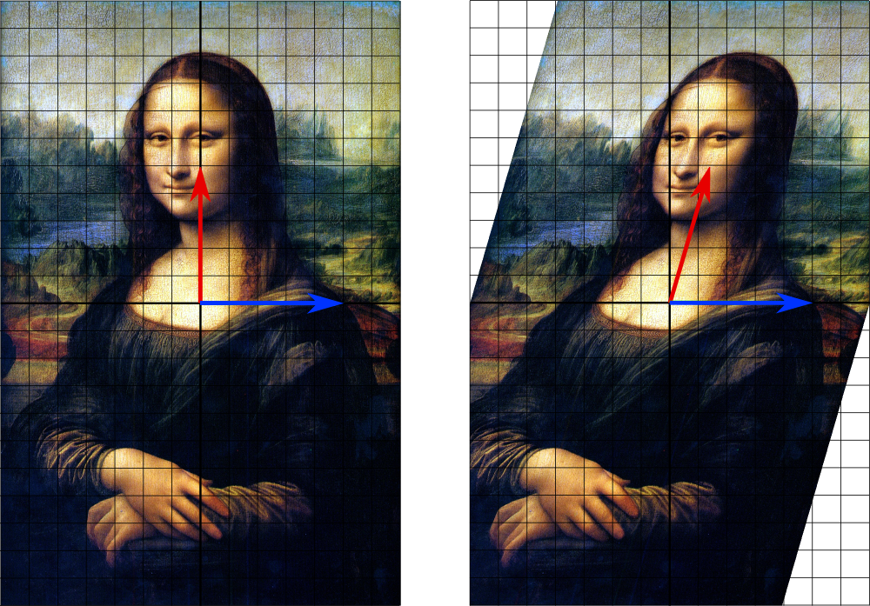
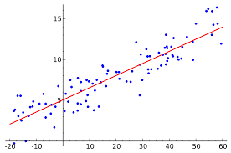
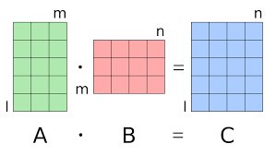
Numerical Linear Algebra in the Sliding Window Model
1 0 1 1 1 0 0 1 1 0 1
Wikipedia

Slide 2
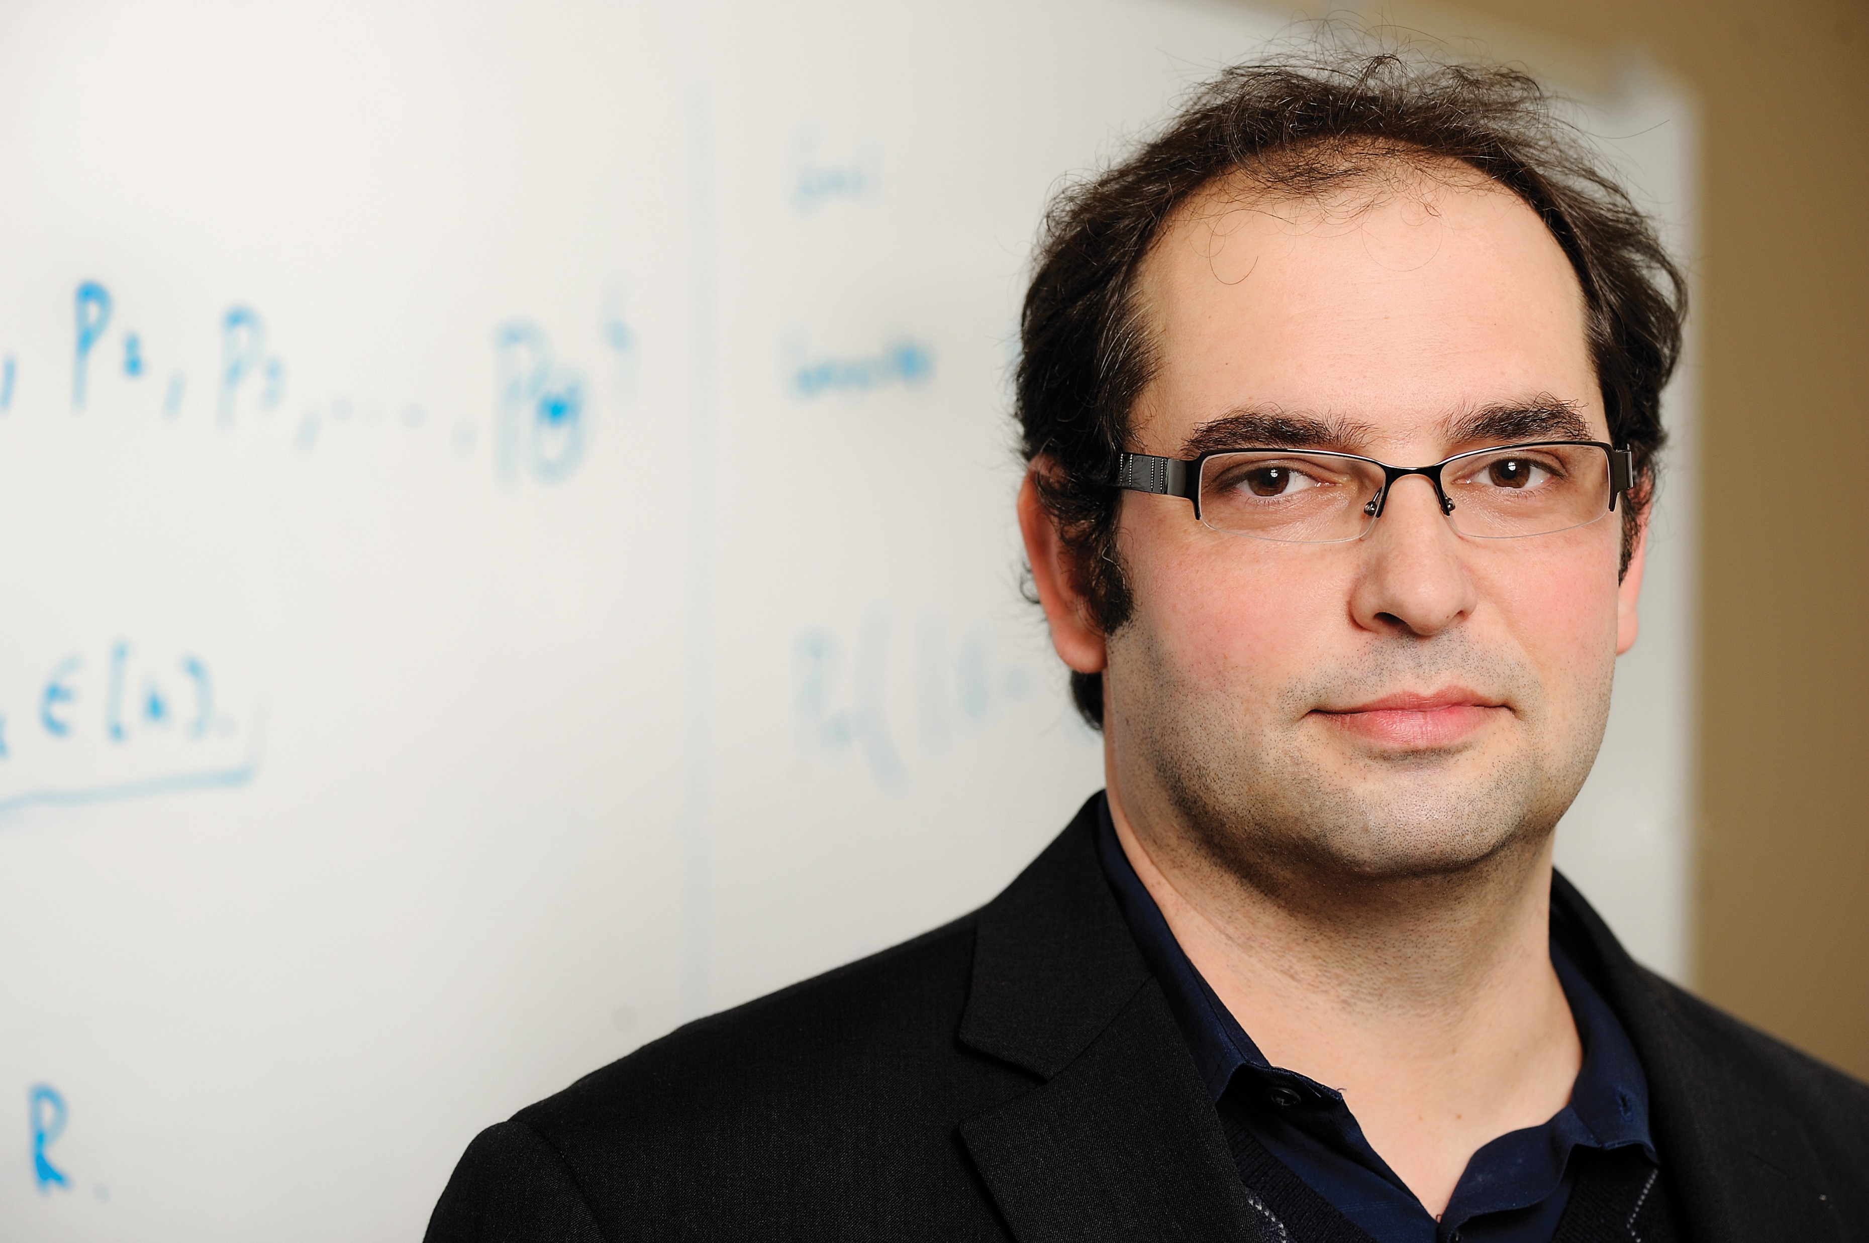








Vladimir Braverman
Petros Drineas
Jalaj Upadhyay
David P. Woodruff
Samson Zhou

Slide 3
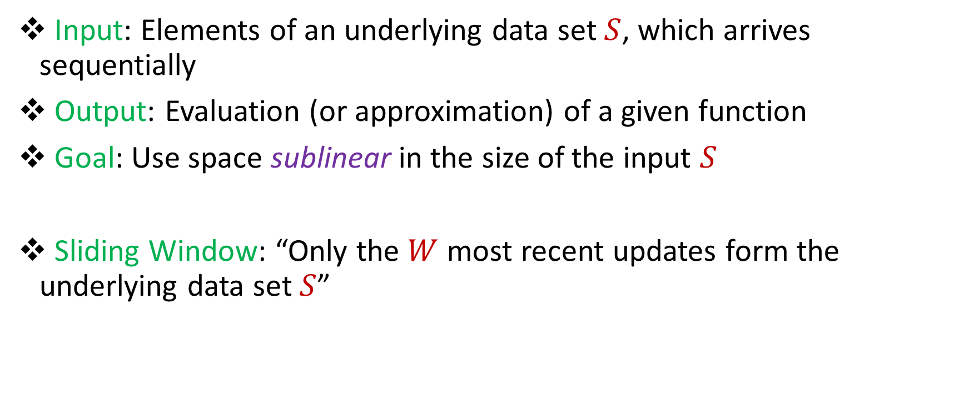
Streaming / Sliding Window Model
Input: Elements of an underlying data set $S$, which arrives sequentially
Output: Evaluation (or approximation) of a given function
Goal: Use space sublinear in the size of the input $S$
Sliding Window: “Only the $W$ most recent updates form the underlying data set $S$”
1 0 1 1 1 0 0 1
Notes:
Let’s start by breaking down each of the terms in the title. To understand the sliding window model, we first have to understand the streaming model of computation, in which elements of an underlying data set S, arrive sequentially and the goal is to evaluate or approximate some given function on this dataset, using space sublinear in S. In the sliding window model, only the W most recent updates form the underlying data set

Slide 4
Streaming / Sliding Window Model
Input: Elements of an underlying data set $S$, which arrives sequentially
Output: Evaluation (or approximation) of a given function
Goal: Use space sublinear in the size of the input $S$
Sliding Window: “Only the $W$ most recent updates form the underlying data set $S$”
1 0 1 1 1 0 0 1 1

Slide 5
Streaming / Sliding Window Model
Input: Elements of an underlying data set $S$, which arrives sequentially
Output: Evaluation (or approximation) of a given function
Goal: Use space sublinear in the size of the input $S$
Sliding Window: “Only the $W$ most recent updates form the underlying data set $S$”
1 0 1 1 1 0 0 1 1 0

Slide 6
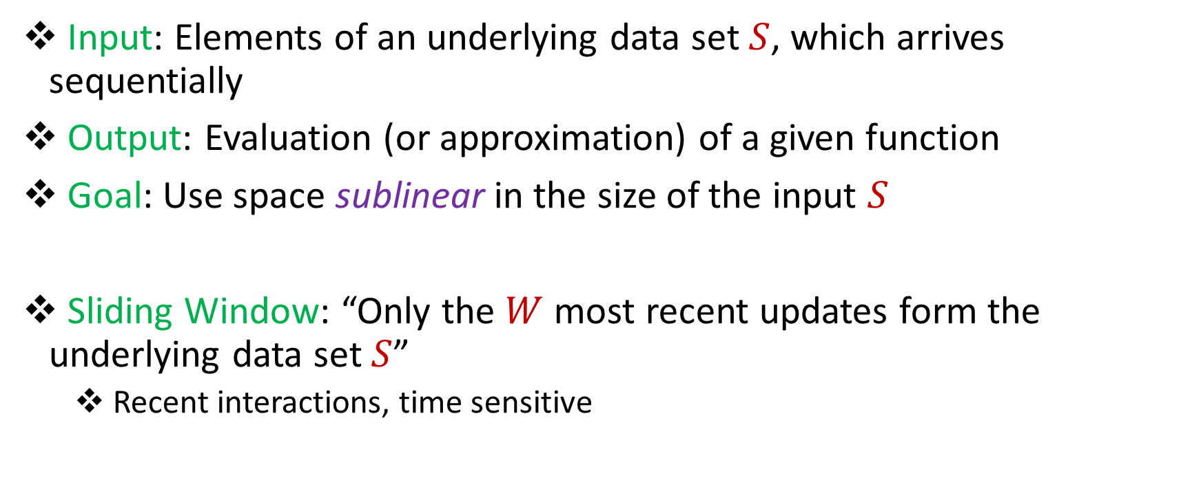
Streaming / Sliding Window Model
Input: Elements of an underlying data set $S$, which arrives sequentially
Output: Evaluation (or approximation) of a given function
Goal: Use space sublinear in the size of the input $S$
Sliding Window: “Only the $W$ most recent updates form the underlying data set $S$”
Recent interactions, time sensitive
1 0 1 1 1 0 0 1 1 0 1
Notes:
The sliding window model emphasizes recent data and thus is appropriate for settings that are time sensitive.

Slide 7

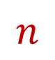
Randomized Numerical Linear Algebra (randNLA) on Sliding Windows
1 3 5 -2 7 0 11 4 -8
0 0 -1 3 13 2 8 6 2
2 5 6 1 4 0 -7 5 3
8 7 2 1 -1 -3 -2 -4 -6
-5 3 -4 -1 -2 -1 0 -3 -1
7 1 3 2 4 1 0 11 1
Rows arrive one-by-one in the data stream
$$W$$
$$n$$
Notes:
Although there’s a number of different streaming update models, in this talk we’ll focus on the row arrival model, where we gets rows of a matrix one at a time.

Slide 8
Randomized Numerical Linear Algebra (randNLA) on Sliding Windows
1 3 5 -2 7 0 11 4 -8
0 0 -1 3 13 2 8 6 2
2 5 6 1 4 0 -7 5 3
8 7 2 1 -1 -3 -2 -4 -6
-5 3 -4 -1 -2 -1 0 -3 -1
7 1 3 2 4 1 0 11 1
1 2 5 -5 4 1 23 4 -3
Rows arrive one-by-one in the data stream
$$W$$
$$n$$

Slide 9
Randomized Numerical Linear Algebra (randNLA) on Sliding Windows
1 3 5 -2 7 0 11 4 -8
0 0 -1 3 13 2 8 6 2
2 5 6 1 4 0 -7 5 3
8 7 2 1 -1 -3 -2 -4 -6
-5 3 -4 -1 -2 -1 0 -3 -1
7 1 3 2 4 1 0 11 1
1 2 5 -5 4 1 23 4 -3
0 5 0 0 7 0 1 31 6
Rows arrive one-by-one in the data stream
$$W$$
$$n$$

Slide 10
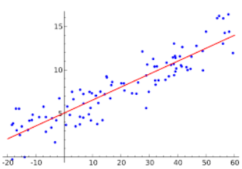
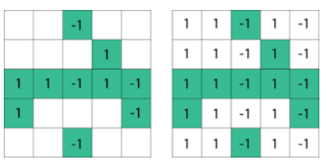
Why randNLA on Sliding Windows?
Sliding window emphasizes efficiency and recency, good for massive data sources and time-sensitive information
We use linear algebra in optimization strategies and prediction of future patterns based on past data, don’t want outdated information
Principal Component Analysis (PCA), Low-Rank Approximation (LRA), Regression
Notes:
As I mentioned, sliding window is a good model for time-sensitive information. We already use tools from linear algebra in applications that are based on optimizing strategies and predicting future patterns based on past data, but we also don’t want to use information that is outdated, so it seems like a natural idea to study numerical linear algebra in the sliding window model.

Slide 11
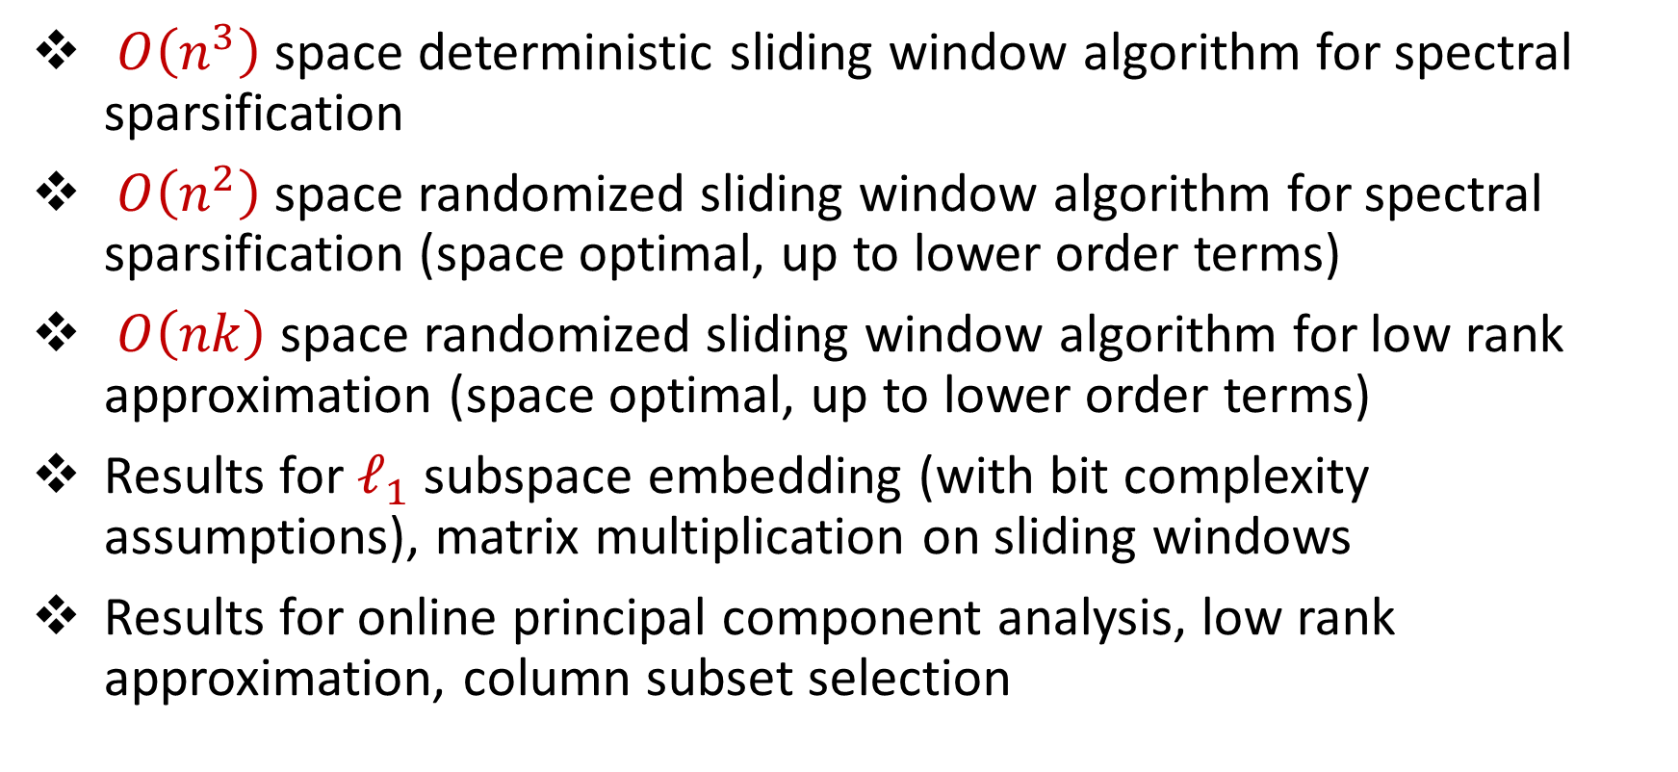
Results
$O\left(n^{3}\right)$space deterministic sliding window algorithm for spectral sparsification
$O\left(n^{2}\right)$space randomized sliding window algorithm for spectral sparsification (space optimal, up to lower order terms)
$O\left(nk\right)$space randomized sliding window algorithm for low rank approximation (space optimal, up to lower order terms)
Results for $ℓ_{1}$ subspace embedding (with bit complexity assumptions), matrix multiplication on sliding windows
Results for online principal component analysis, low rank approximation, column subset selection
Notes:
In this talk, we’ll focus on a space-optimal algorithm for spectral sparsification and then I’ll talk about how to modify the algorithm to get a space-optimal algorithm for low-rank approximation. Before I begin though, I’d like to advertise some other results in this work that I think are really interesting. We also get a deterministic algorithm for spectral sparsification. That’s not space optimal like the randomized algorithm but it presents a natural way of thinking about this problem that is a generalization of smooth histogram framework. We also get sliding window algorithms for L1 subspace embedding with bit complexity assumptions as well as matrix multiplication. Finally, we obtain a number of algorithms for numerical linear algebra in the online setting, which is a cool model that the next speaker will talk about.

Slide 12
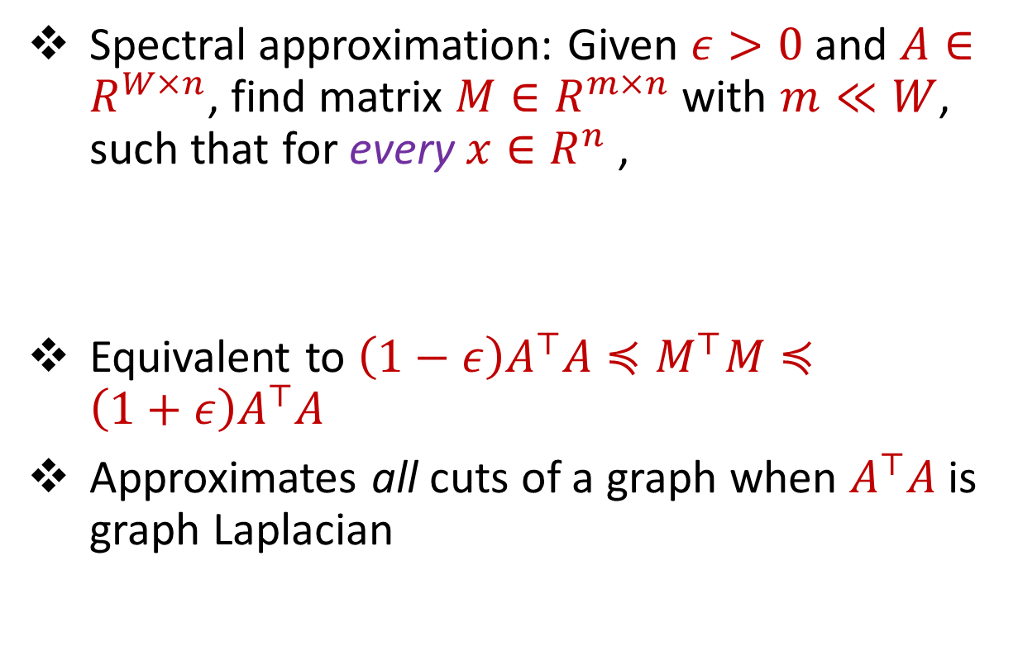

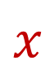

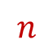
Spectral Sparsification
Spectral approximation: Given $ε>0$ and $A∈R^{W×n}$, find matrix $M∈R^{m×n}$ with $m≪W$, such that for every $x∈R^{n}$,
Equivalent to $\left(1−ε\right)A^{⊤}A≼M^{⊤}M≼\left(1+ε\right)A^{⊤}A$
Approximates all cuts of a graph when $A^{⊤}A$ is graph Laplacian
$$A$$
$$x$$
$$W$$
$$\left(1−ε\right){\left\|Ax\right\|}_{2}≤{\left\|Mx\right\|}_{2}≤\left(1+ε\right){\left\|Ax\right\|}_{2}$$
$$n$$

Slide 13

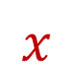

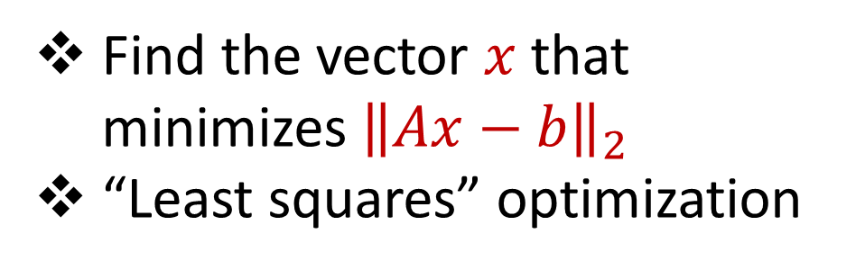

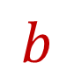
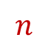

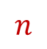

Linear Regression
Find the vector $x$ that minimizes ${\left\|Ax−b\right\|}_{2}$
“Least squares” optimization
$$n$$
$$x$$
$$≈$$
$$W$$
$$A$$
$$W$$
$$b$$
$$1$$
$$n$$
$$1$$

Slide 14


Challenges
Approach 1: Use smooth histogram [BO07] technique for sliding windows
…Functions are not smooth
Approach 2: Use sketching techniques for subspace embeddings
…Cannot undue expirations from sliding window
-2 7 0 11 4 -8
3 13 2 8 6 2
1 4 0 -7 5 3
1 -1 -3 -2 -4 -6
-1 -2 -1 0 -3 -1
2 4 1 0 11 1
$$P$$
$$A$$

Slide 15
Challenges
Approach 1: Use smooth histogram [BO07] technique for sliding windows
…Functions are not smooth
Approach 2: Use sketching techniques for subspace embeddings
…Cannot undue expirations from sliding window
-2 7 0 11 4 -8
3 13 2 8 6 2
1 4 0 -7 5 3
1 -1 -3 -2 -4 -6
-1 -2 -1 0 -3 -1
2 4 1 0 11 1
5 0 4 1 0 -11
$$P$$
$$A$$

Slide 16
Challenges
Approach 1: Use smooth histogram [BO07] technique for sliding windows
…Functions are not smooth
Approach 2: Use sketching techniques for subspace embeddings
…Cannot undue expirations from sliding window
Approach 3: Use sampling techniques for data streams, e.g., sample rows that are unique
…Recent rows seem to be more important
-2 7 0 11 4 -8
3 13 2 8 6 2
1 4 0 -7 5 3
1 -1 -3 -2 -4 -6
-1 -2 -1 0 -3 -1
2 4 1 0 11 1
5 0 4 1 0 -11
$$P$$
$$A$$

Slide 17
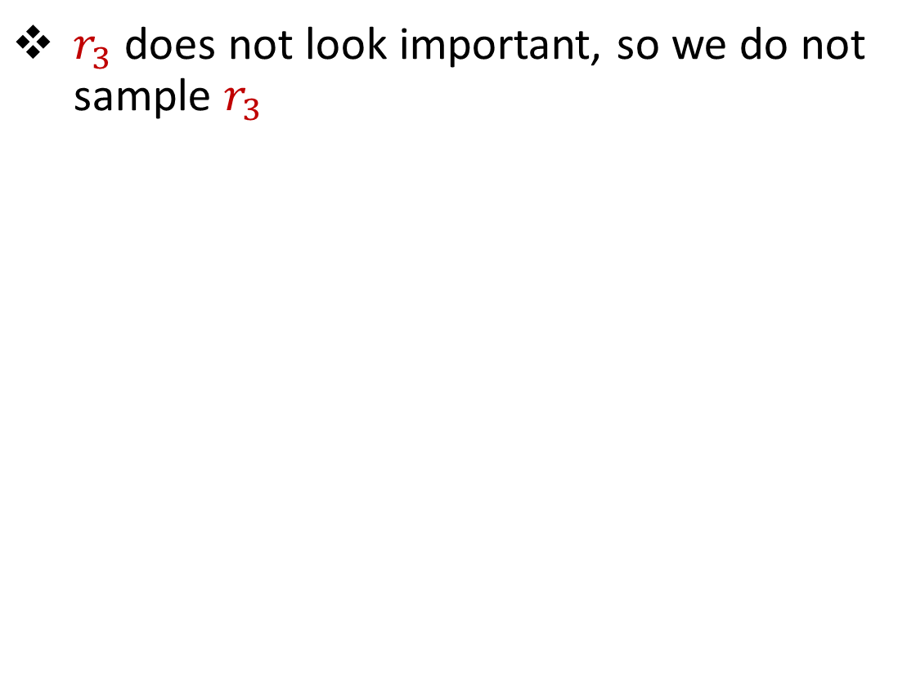
Challenges
$r_{3}$ does not look important, so we do not sample $r_{3}$
1 3 5 -2 7 0 11 4 -8
0 0 0 0 0 0 0 0 100
0 0 0 0 0 0 0 0 1

Slide 18
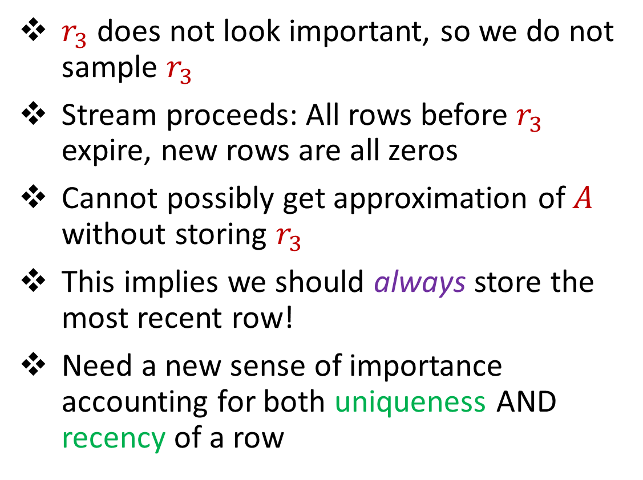
Challenges
$r_{3}$ does not look important, so we do not sample $r_{3}$
Stream proceeds: All rows before $r_{3}$ expire, new rows are all zeros
Cannot possibly get approximation of $A$ without storing $r_{3}$
This implies we should always store the most recent row!
Need a new sense of importance accounting for both uniqueness AND recency of a row
1 3 5 -2 7 0 11 4 -8
0 0 0 0 0 0 0 0 100
0 0 0 0 0 0 0 0 1
0 0 0 0 0 0 0 0 0
0 0 0 0 0 0 0 0 0
0 0 0 0 0 0 0 0 0
0 0 0 0 0 0 0 0 0
0 0 0 0 0 0 0 0 0

Slide 19
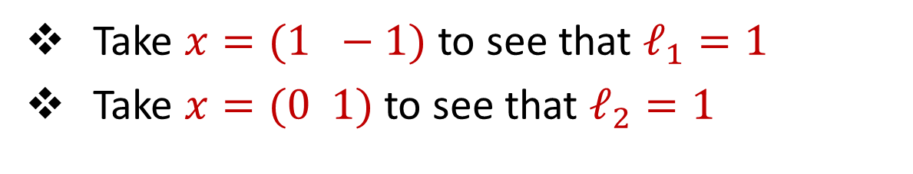
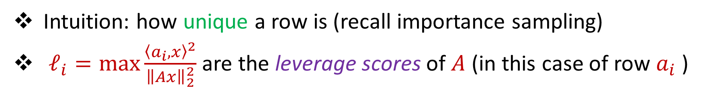
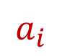

Leverage Scores
Intuition: how unique a row is (recall importance sampling)
$ℓ_{i}=\max{\frac{{\left\langle a_{i},x\right\rangle }^{2}}{{\left\|Ax\right\|}_{2}^{2}}}$ are the leverage scores of $A$ (in this case of row $a_{i}$ )
Take $x=(1 −1)$ to see that $ℓ_{1}=1$
Take $x=(0 1)$ to see that $ℓ_{2}=1$
1 0
1 1
$ℓ_{i}=a_{i}{\left(A^{⊤}A\right)}^{−1}a_{i}^{⊤}$, ${∑ℓ}_{i}=n$
$$A$$
$$a_{i}$$

Slide 20


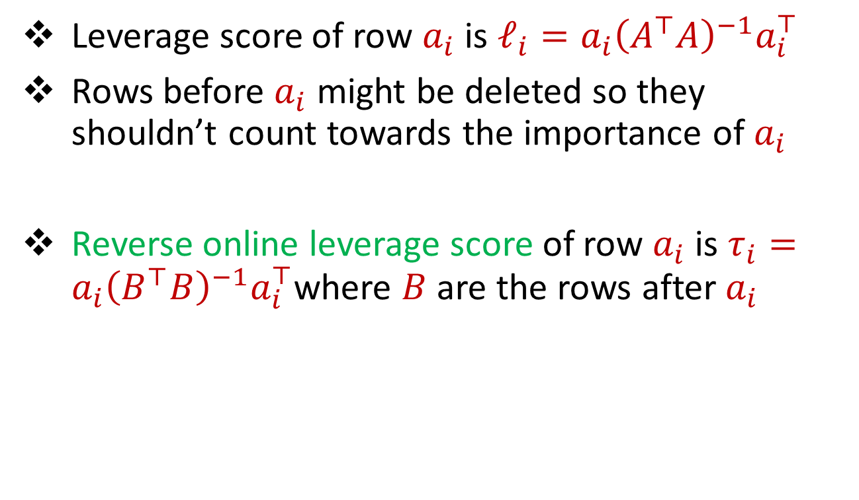
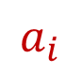


Reverse Online Leverage Scores
$$A$$
Leverage score of row $a_{i}$ is $ℓ_{i}=a_{i}{\left(A^{⊤}A\right)}^{−1}a_{i}^{⊤}$
Rows before $a_{i}$ might be deleted so they shouldn’t count towards the importance of $a_{i}$
Reverse online leverage score of row $a_{i}$ is $τ_{i}=a_{i}{\left(B^{⊤}B\right)}^{−1}a_{i}^{⊤}$where $B$ are the rows after $a_{i}$
$$a_{i}$$
$$A$$
$$a_{i}$$
$$B$$

Slide 21

Algorithm
Algorithm: sample (and rescale) a number of rows
$$A$$

Slide 22
Algorithm
Algorithm: sample (and rescale) a number of rows
New row arrives – store it
$$A$$

Slide 23
Algorithm
Algorithm: sample (and rescale) a number of rows
New row arrives – store it
$$A$$

Slide 24
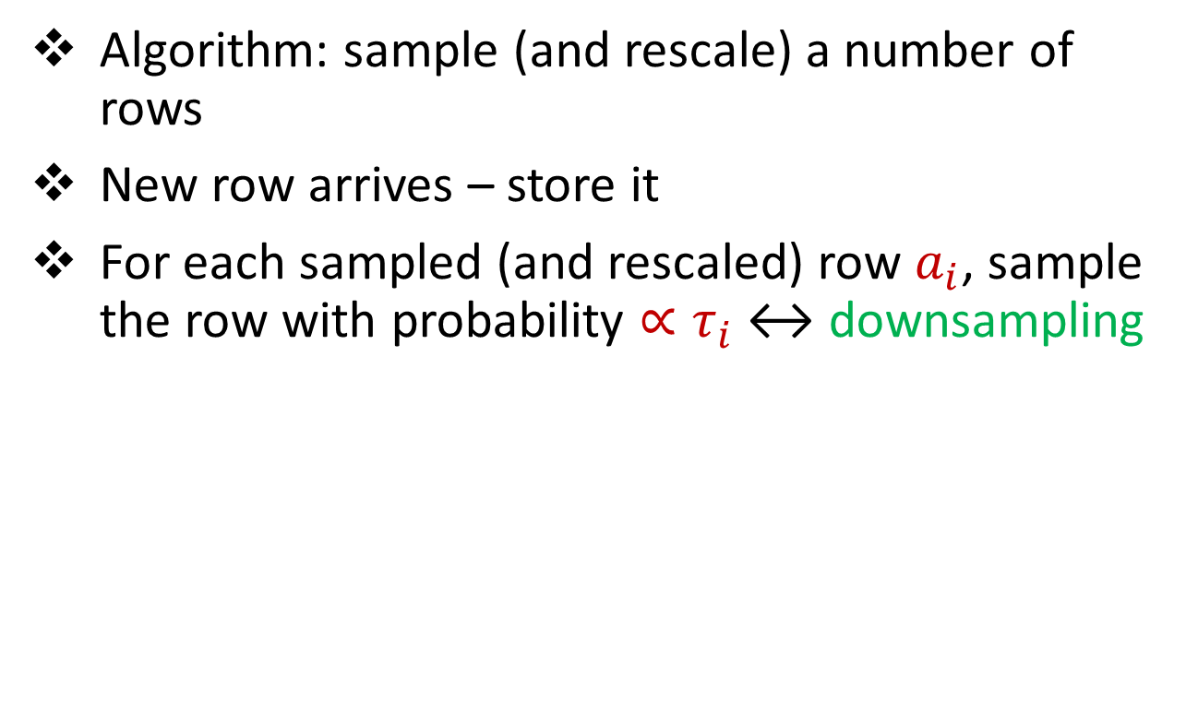
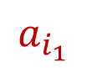
Algorithm
Algorithm: sample (and rescale) a number of rows
New row arrives – store it
For each sampled (and rescaled) row $a_{i}$, sample the row with probability ${∝τ}_{i}$ ↔ downsampling
$$A$$
$$a_{i_{1}}$$

Slide 25
Algorithm
Algorithm: sample (and rescale) a number of rows
New row arrives – store it
For each sampled (and rescaled) row $a_{i}$, sample the row with probability ${∝τ}_{i}$ ↔ downsampling
$$A$$
$$a_{i_{1}}$$

Slide 26
Algorithm
Algorithm: sample (and rescale) a number of rows
New row arrives – store it
For each sampled (and rescaled) row $a_{i}$, sample the row with probability ${∝τ}_{i}$ ↔ downsampling
$$A$$
$$a_{i_{1}}$$

Slide 27
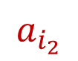
Algorithm
Algorithm: sample (and rescale) a number of rows
New row arrives – store it
For each sampled (and rescaled) row $a_{i}$, sample the row with probability ${∝τ}_{i}$ ↔ downsampling
$$A$$
$$a_{i_{2}}$$

Slide 28
Algorithm
Algorithm: sample (and rescale) a number of rows
New row arrives – store it
For each sampled (and rescaled) row $a_{i}$, sample the row with probability ${∝τ}_{i}$ ↔ downsampling
$$A$$
$$a_{i_{2}}$$

Slide 29
Algorithm
Algorithm: sample (and rescale) a number of rows
New row arrives – store it
For each sampled (and rescaled) row $a_{i}$, sample the row with probability ${∝τ}_{i}$ ↔ downsampling
$$A$$
$$a_{i_{2}}$$

Slide 30
Algorithm
Algorithm: sample (and rescale) a number of rows
New row arrives – store it
For each sampled (and rescaled) row $a_{i}$, sample the row with probability ${∝τ}_{i}$ ↔ downsampling
$$A$$
$$a_{i_{2}}$$

Slide 31
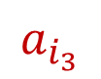
Algorithm
Algorithm: sample (and rescale) a number of rows
New row arrives – store it
For each sampled (and rescaled) row $a_{i}$, sample the row with probability ${∝τ}_{i}$ ↔ downsampling
$$A$$
$$a_{i_{3}}$$

Slide 32
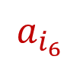
Algorithm
$$a_{i_{6}}$$
Algorithm: sample (and rescale) a number of rows
New row arrives – store it
For each sampled (and rescaled) row $a_{i}$, sample the row with probability ${∝τ}_{i}$ ↔ downsampling
$$A$$

Slide 33
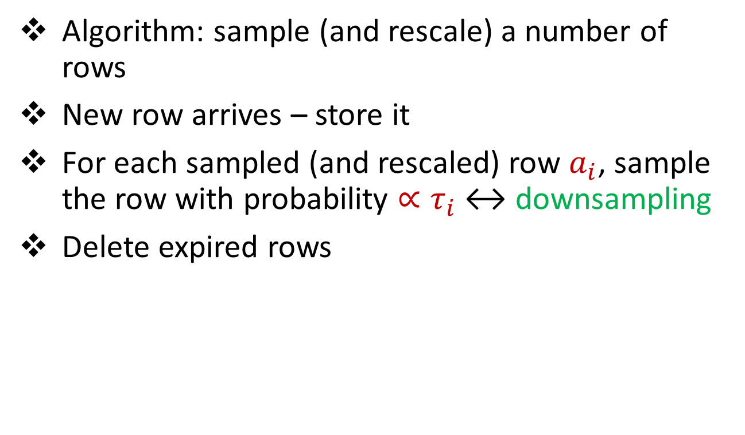
Algorithm
$$a_{i_{6}}$$
Algorithm: sample (and rescale) a number of rows
New row arrives – store it
For each sampled (and rescaled) row $a_{i}$, sample the row with probability ${∝τ}_{i}$ ↔ downsampling
Delete expired rows
$$A$$

Slide 34
Algorithm
$$a_{i_{6}}$$
Algorithm: sample (and rescale) a number of rows
New row arrives – store it
For each sampled (and rescaled) row $a_{i}$, sample the row with probability ${∝τ}_{i}$ ↔ downsampling
Delete expired rows
$$A$$

Slide 35
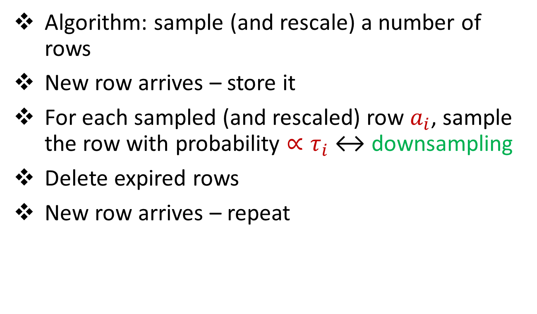
Algorithm
Algorithm: sample (and rescale) a number of rows
New row arrives – store it
For each sampled (and rescaled) row $a_{i}$, sample the row with probability ${∝τ}_{i}$ ↔ downsampling
Delete expired rows
New row arrives – repeat
$$A$$

Slide 36
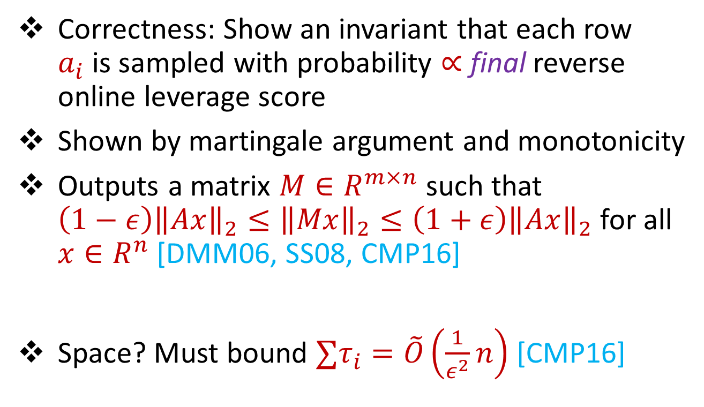

Spectral Sparsification (Summary)
Correctness: Show an invariant that each row $a_{i}$is sampled with probability $∝$ final reverse online leverage score
Shown by martingale argument and monotonicity
Outputs a matrix $M∈R^{m×n}$ such that $\left(1−ε\right){\left\|Ax\right\|}_{2}≤{\left\|Mx\right\|}_{2}≤\left(1+ε\right){\left\|Ax\right\|}_{2}$ for all $x∈R^{n}$ [DMM06, SS08, CMP16]
Space? Must bound ${∑τ}_{i}=\tilde{O}\left(\frac{1}{ε^{2}}n\right)$ [CMP16]
$$A$$
$$a_{i}$$

Slide 37
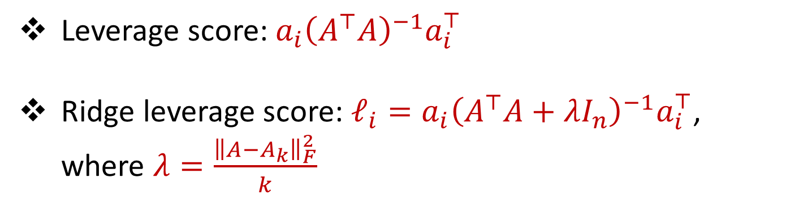
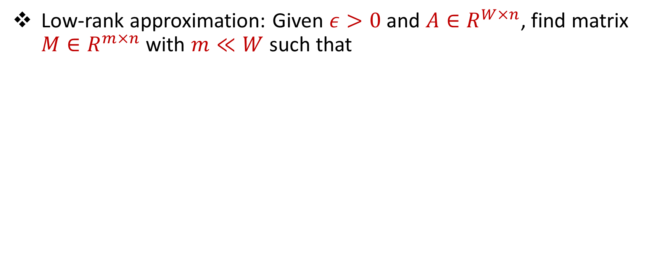

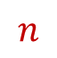

Low-Rank Approximation
Low-rank approximation: Given $ε>0$ and $A∈R^{W×n}$, find matrix $M∈R^{m×n}$ with $m≪W$ such that
$$\left(1−ε\right){\left\|A−A_{k}\right\|}_{F}^{2}≤{\left\|M−M_{k}\right\|}_{F}^{2}≤\left(1+ε\right){\left\|A−A_{k}\right\|}_{F}^{2}$$
Leverage score: $a_{i}{\left(A^{⊤}A\right)}^{−1}a_{i}^{⊤}$
Ridge leverage score: $ℓ_{i}=a_{i}{\left(A^{⊤}A+λI_{n}\right)}^{−1}a_{i}^{⊤}$, where $λ=\frac{{\left\|A−A_{k}\right\|}_{F}^{2}}{k}$
$$W$$
$$A$$
$$n$$

Slide 38
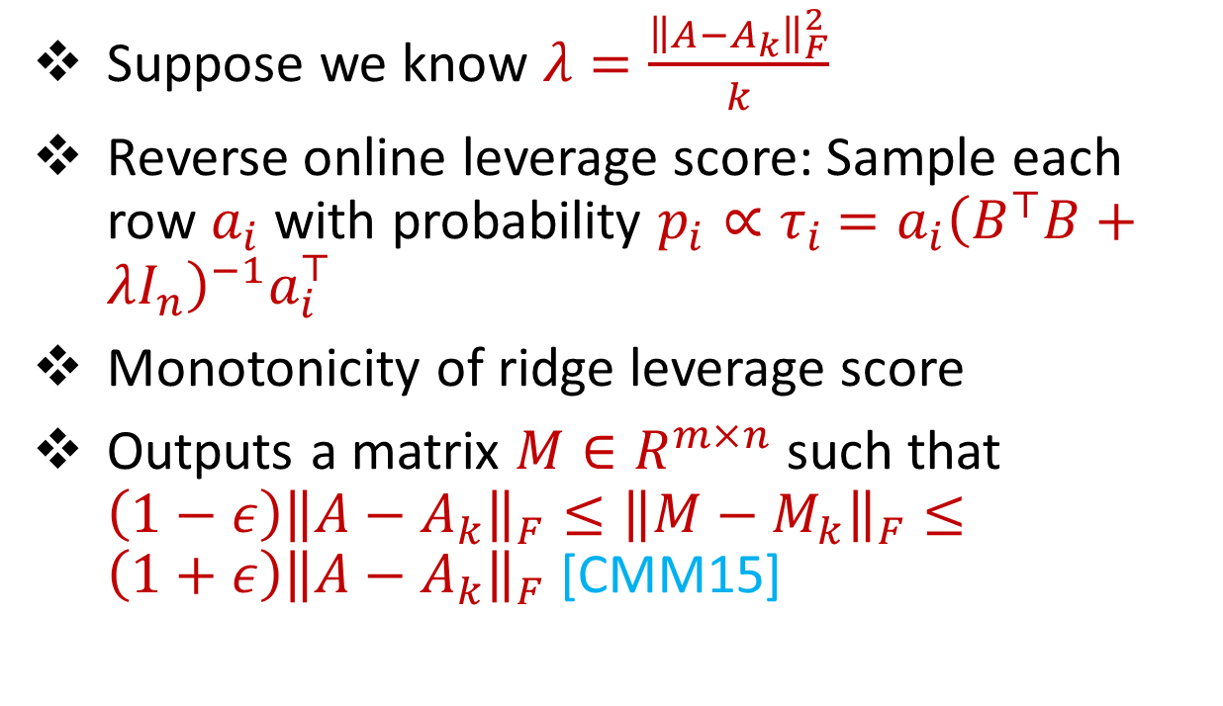
Template
$$A$$
Suppose we know $λ=\frac{{\left\|A−A_{k}\right\|}_{F}^{2}}{k}$
Reverse online leverage score: Sample each row $a_{i}$ with probability $p_{i}∝τ_{i}$ $=a_{i}{\left(B^{⊤}B+λI_{n}\right)}^{−1}a_{i}^{⊤}$
Monotonicity of ridge leverage score
Outputs a matrix $M∈R^{m×n}$ such that $\left(1−ε\right){\left\|A−A_{k}\right\|}_{F}≤{\left\|M−M_{k}\right\|}_{F}≤\left(1+ε\right){\left\|A−A_{k}\right\|}_{F}$ [CMM15]
$$a_{i}$$
$$A$$
$$a_{i}$$
$$B$$

Slide 39
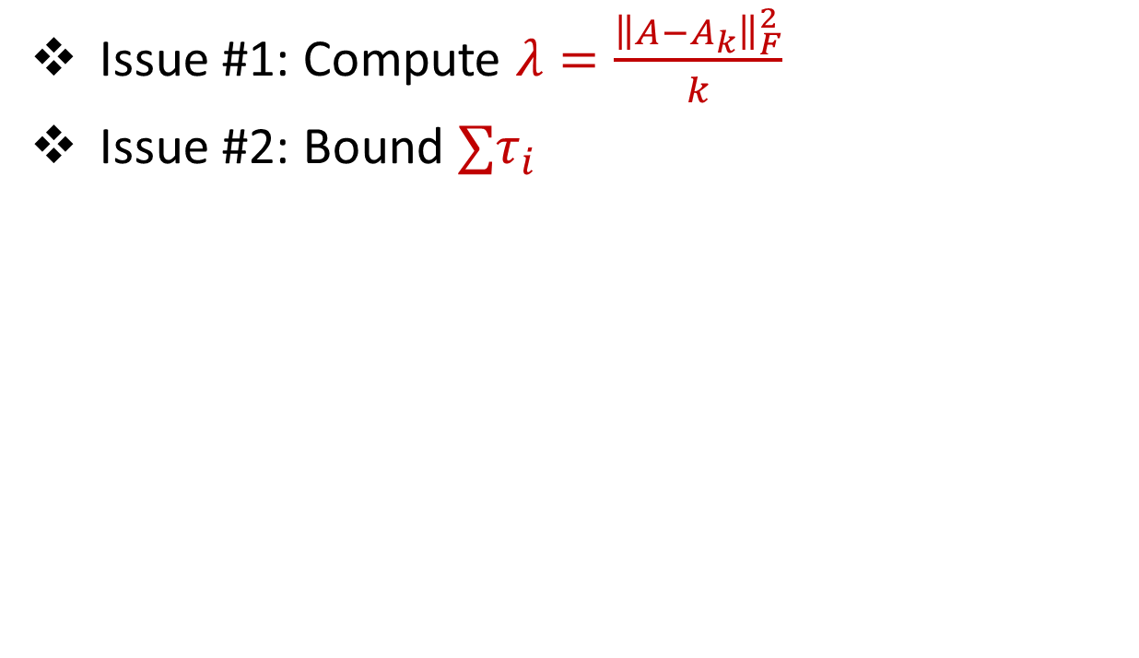
Template
$$A$$
Issue #1: Compute $λ=\frac{{\left\|A−A_{k}\right\|}_{F}^{2}}{k}$
Issue #2: Bound ${∑τ}_{i}$
$$a_{i}$$
$$A$$
$$a_{i}$$
$$B$$

Slide 40
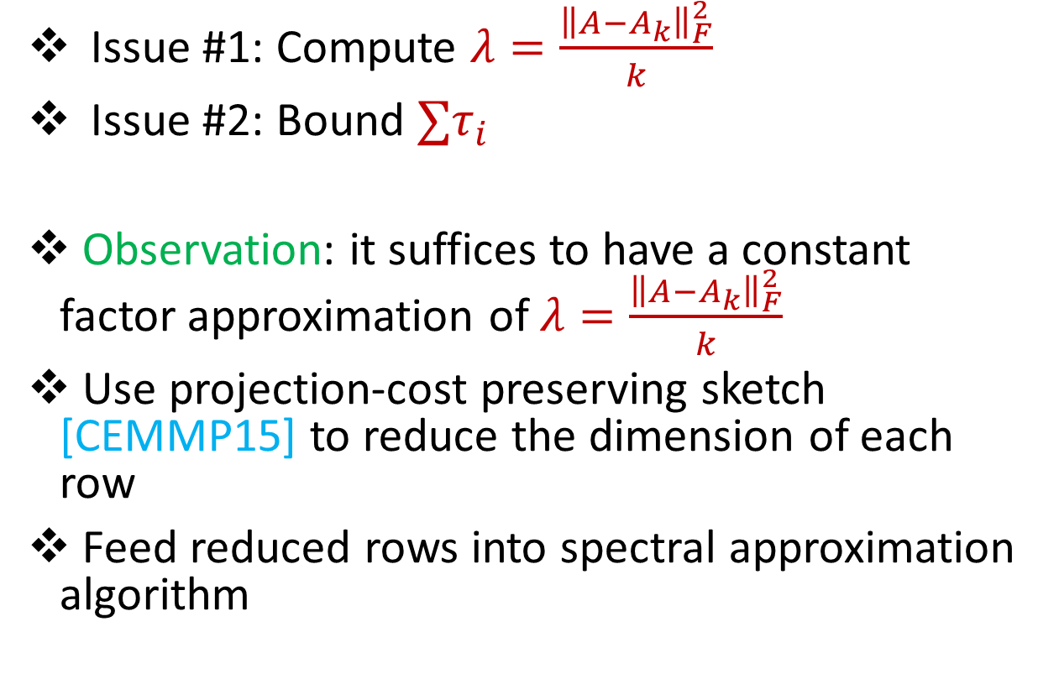
Template
$$A$$
Issue #1: Compute $λ=\frac{{\left\|A−A_{k}\right\|}_{F}^{2}}{k}$
Issue #2: Bound ${∑τ}_{i}$
Observation: it suffices to have a constant factor approximation of $λ=\frac{{\left\|A−A_{k}\right\|}_{F}^{2}}{k}$
Use projection-cost preserving sketch [CEMMP15] to reduce the dimension of each row
Feed reduced rows into spectral approximation algorithm
$$a_{i}$$
$$A$$
$$a_{i}$$
$$B$$

Slide 41

Template
$$A$$
Issue #1: Compute $λ=\frac{{\left\|A−A_{k}\right\|}_{F}^{2}}{k}$
Issue #2: Bound ${∑τ}_{i}$
$$a_{i}$$
$$A$$
$$a_{i}$$
$$B$$

Slide 42
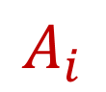
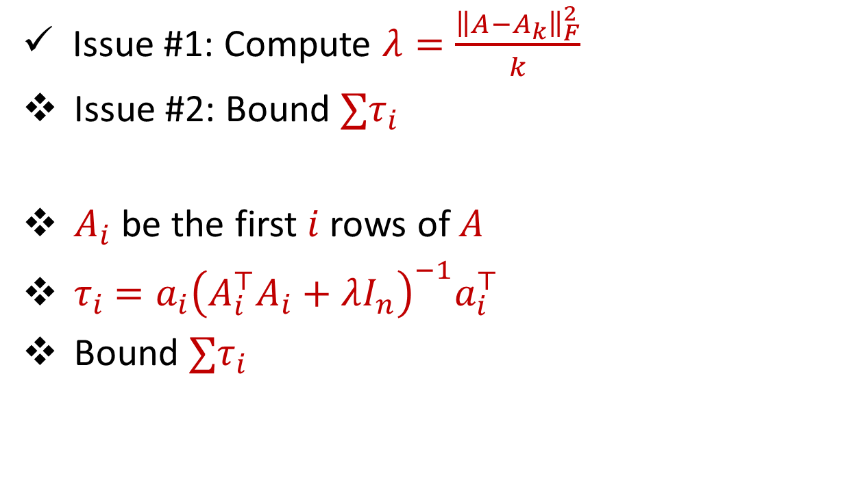


Template
$$A$$
Issue #1: Compute $λ=\frac{{\left\|A−A_{k}\right\|}_{F}^{2}}{k}$
Issue #2: Bound ${∑τ}_{i}$
$A_{i}$ be the first $i$ rows of $A$
$τ_{i}$ $=a_{i}{\left(A_{i}^{⊤}A_{i}+λI_{n}\right)}^{−1}a_{i}^{⊤}$
Bound ${∑τ}_{i}$
$$a_{i}$$
$$A_{i}$$
$$A$$
$$A$$
$$a_{i}$$
$$a_{i}$$
$$B$$

Slide 43
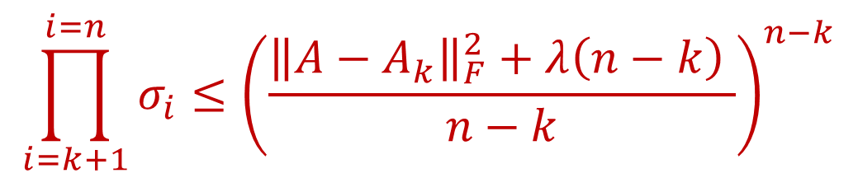
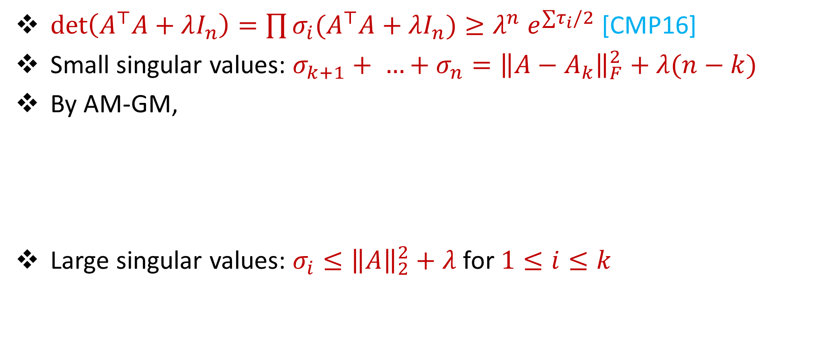
Bounding the Determinant
$\det\left(A^{⊤}A+λI_{n}\right)=\prod{σ_{i}(A^{⊤}A+λI_{n}\text{)}}≥λ^{n} e^{{∑τ}_{i}/2}$ [CMP16]
Small singular values: $σ_{k+1}+ …+σ_{n}={\left\|A−A_{k}\right\|}_{F}^{2}+λ(n−k)$
By AM-GM,
Large singular values: $σ_{i}≤{\left\|A\right\|}_{2}^{2}+λ$ for $1≤i≤k$
$$\prod_{i=k+1}^{i=n}{σ_{i}}≤{\left(\frac{{\left\|A−A_{k}\right\|}_{F}^{2}+λ\left(n−k\right) }{n−k}\right)}^{n−k}$$
$$log det{(}A^{⊤}A+λI_{n})=O(k log n)$$

Slide 44
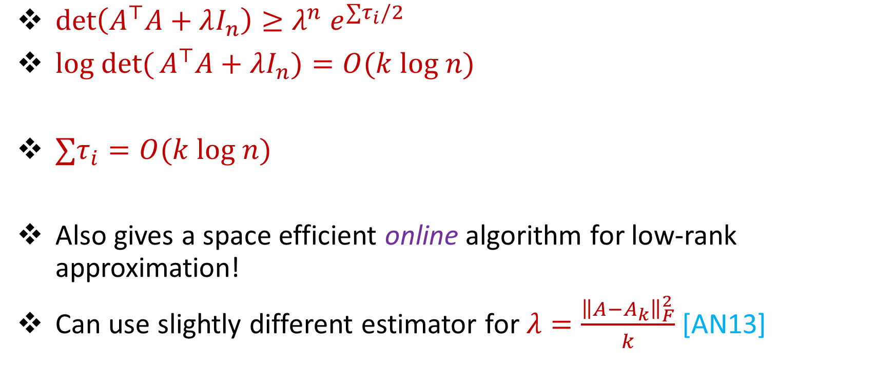
Reverse Online Leverage Scores
$\det\left(A^{⊤}A+λI_{n}\right)≥λ^{n}$ $e^{{∑τ}_{i}/2}$
$log det{(}A^{⊤}A+λI_{n})=O(k log n)$
${∑τ}_{i}=O(k log n)$
Also gives a space efficient online algorithm for low-rank approximation!
Can use slightly different estimator for $λ=\frac{{\left\|A−A_{k}\right\|}_{F}^{2}}{k}$ [AN13]

Slide 45

Template
$$A$$
Issue #1: Compute $λ=\frac{{\left\|A−A_{k}\right\|}_{F}^{2}}{k}$
Issue #2: Bound ${∑τ}_{i}$
$$a_{i}$$
$$A$$
$$a_{i}$$
$$B$$

Slide 46

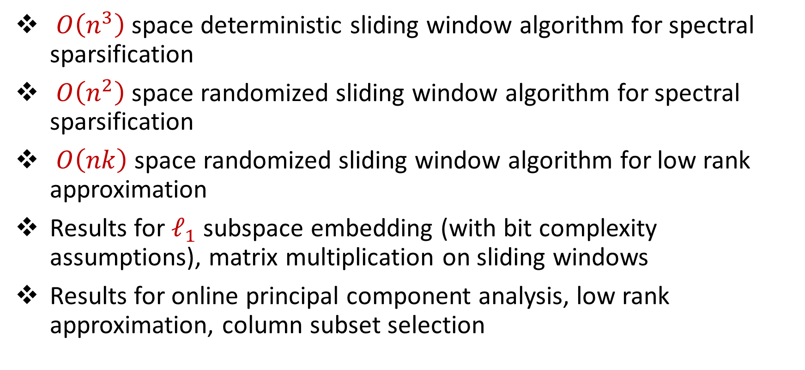
Summary
$O\left(n^{3}\right)$space deterministic sliding window algorithm for spectral sparsification
$O\left(n^{2}\right)$space randomized sliding window algorithm for spectral sparsification
$O\left(nk\right)$space randomized sliding window algorithm for low rank approximation
Results for $ℓ_{1}$ subspace embedding (with bit complexity assumptions), matrix multiplication on sliding windows
Results for online principal component analysis, low rank approximation, column subset selection

Slide 47
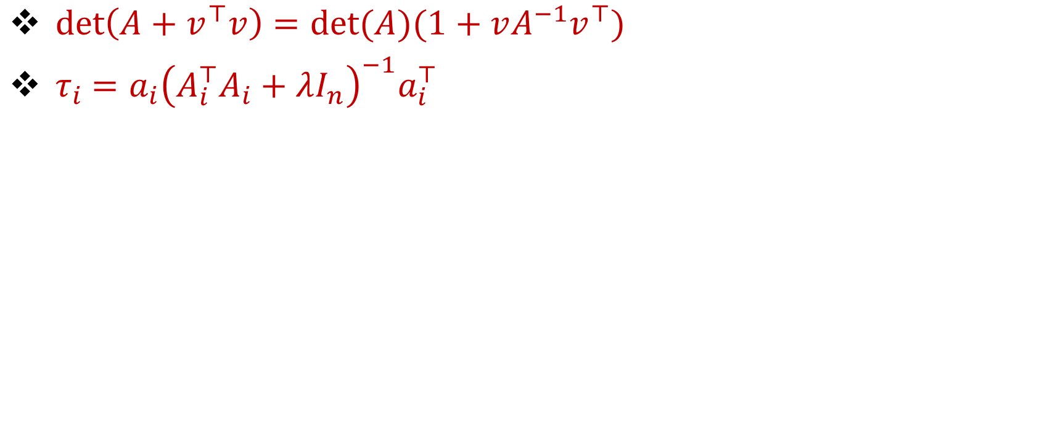
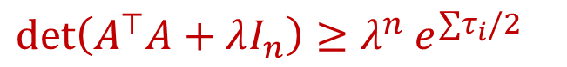
Using Matrix Determinant Lemma [CMP16]
$\det\left(A+v^{⊤}v\right)=det⁡(A)(1+vA^{−1}v^{⊤})$
$τ_{i}$ $=a_{i}{\left(A_{i}^{⊤}A_{i}+λI_{n}\right)}^{−1}a_{i}^{⊤}$
$$\det\left(A^{⊤}A+λI_{n}\right)=\det\left(A_{W−1}^{⊤}A_{W−1}+λI_{n}\right)(1+a_{W}{\left(A_{W−1}^{⊤}A_{W−1}+λI_{n}\right)}^{−1}a_{W}^{⊤})$$
$$=\det\left(A_{W−1}^{⊤}A_{W−1}+λI_{n}\right)(1+τ_{W})$$
$$≥\det\left(A_{W−1}^{⊤}A_{W−1}+λI_{n}\right)\left(1+e^{τ_{w}/2}\right)$$
$\det\left(A^{⊤}A+λI_{n}\right)≥λ^{n}$ $e^{{∑τ}_{i}/2}$

